Slide 1
Patson Machines CRM Workflow Architecture and Planning

Slide 2
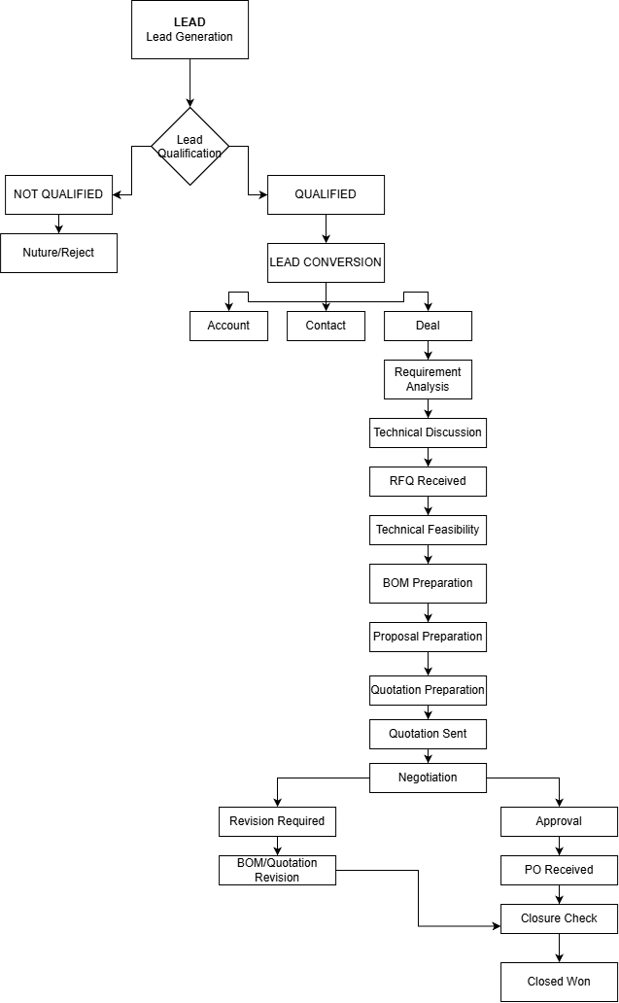
Proposed Architecture

Slide 3
Implementation Plan
Phase 1: Lead Qualification
Phase 2: Lead Conversion
Decide what makes a Patson lead 'Qualified'
Define the lead qualification fields
Create the field.
Decide which fields are mandatory.
Create the qualification statuses.
Configure lead conversion mapping.
Configure lead conversion into Contacts, Accounts, and Deal.
Map lead to Account
Map lead to Contact
Map lead to Deal
Test the Conversion

Slide 4
Implementation Plan
Phase 3: RFQ management
Phase 4: BOM Management
Review the existing RFQ module.
Cleanup its fields
Add required document/file storage
Establish RFQ-Deal relationship
Create a separate BOM Module
Create BOM fields
Create BOM item structure
Add file and document Storage
Link BOM, Deal, and RFQ.

Slide 5
Implementation Plan
Phase 5: Quotation management
Phase 6: Deal Blueprint
Create Quotation module.
Create quotation fields
Add revision management.
Add quotation document storage.
Link Quotation to Deal, RFQ and BOM modules.
Modify the existing blueprint
Connect BOM preparation to BOM module
Connect Quotation preparation to Quotation module.
Add revision loops
Configure Approvals
Configure Closed Won/Closed Lost

Slide 6
Implementation Plan
Phase 7: Automation
Phase 8: Testing
Record Locking
Notifications
Workflow Automation
Create a Dummy lead
Qualify it
Convert the lead into Contact, Account and Deal
Create RFQ
Prepare BOM
Prepare Quotation
Revise Quotation if required
Receive Purchase Order(PO)
Close Won
Verify that all information and files can we retrieved later.

